Slide 1

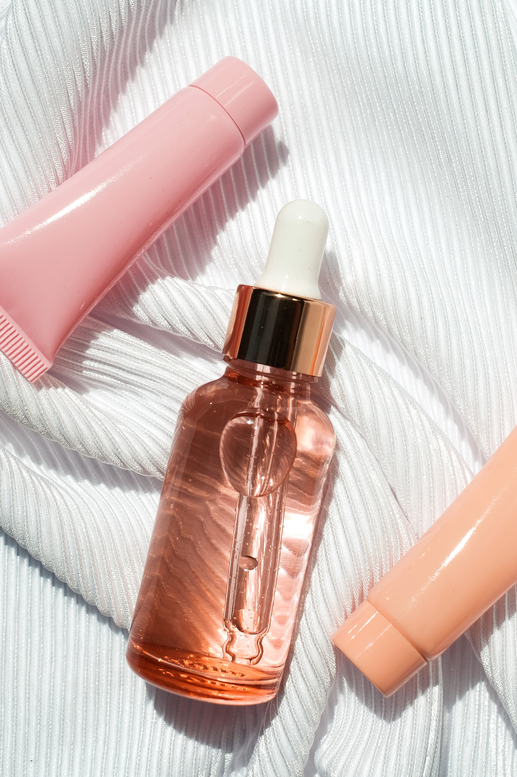
Cosmetics Suggestion Using AI
Presented by: Anuhya Lanke,
Hari Prasad Daggupati,
Mingji Li

Slide 2

1
Introduction
Table Of Content
2
Existing System
3
Proposed System
4
Result
5
Demo
In Presentations we are going to cover the following things
Conclusion
6
7
Reference
3

Slide 3
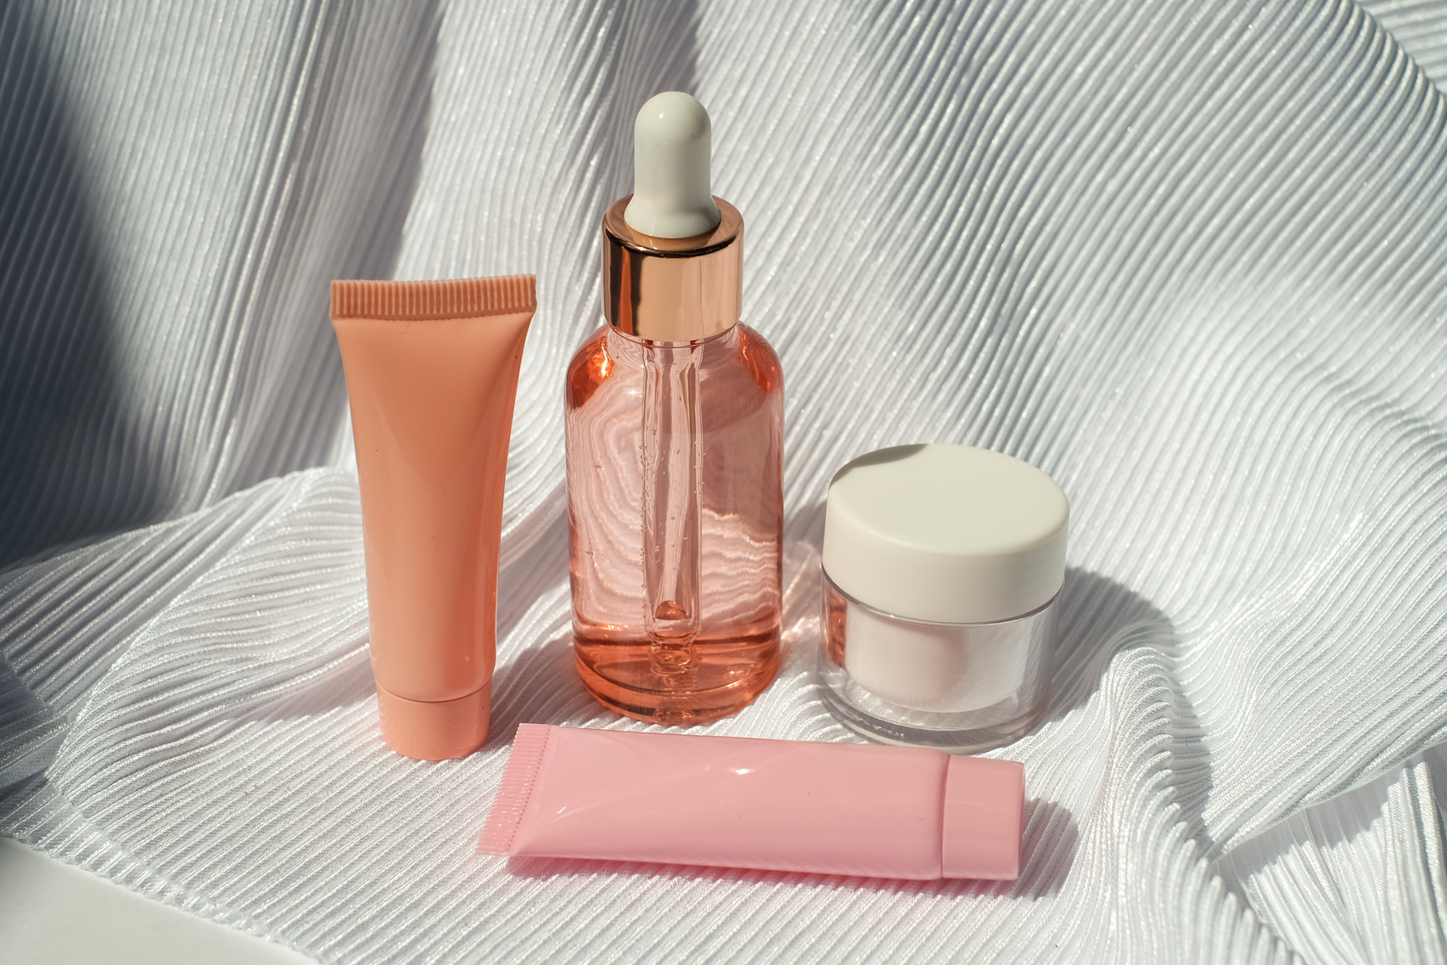
Introduction
Purpose: Cosmetic suggestion systems aim to recommend skincare and beauty products tailored to individual needs based on skin type, preferences, and reviews.
Significance: With the growing variety of products, such systems simplify decision-making, ensuring better product compatibility and user satisfaction.
Technological Evolution: Modern approaches utilize AI, deep learning, and natural language processing to analyze user reviews, product descriptions, and images.
Impact: Personalized recommendations enhance user trust, reduce product mismatches, and improve overall customer experience in the cosmetic industry.

Slide 4
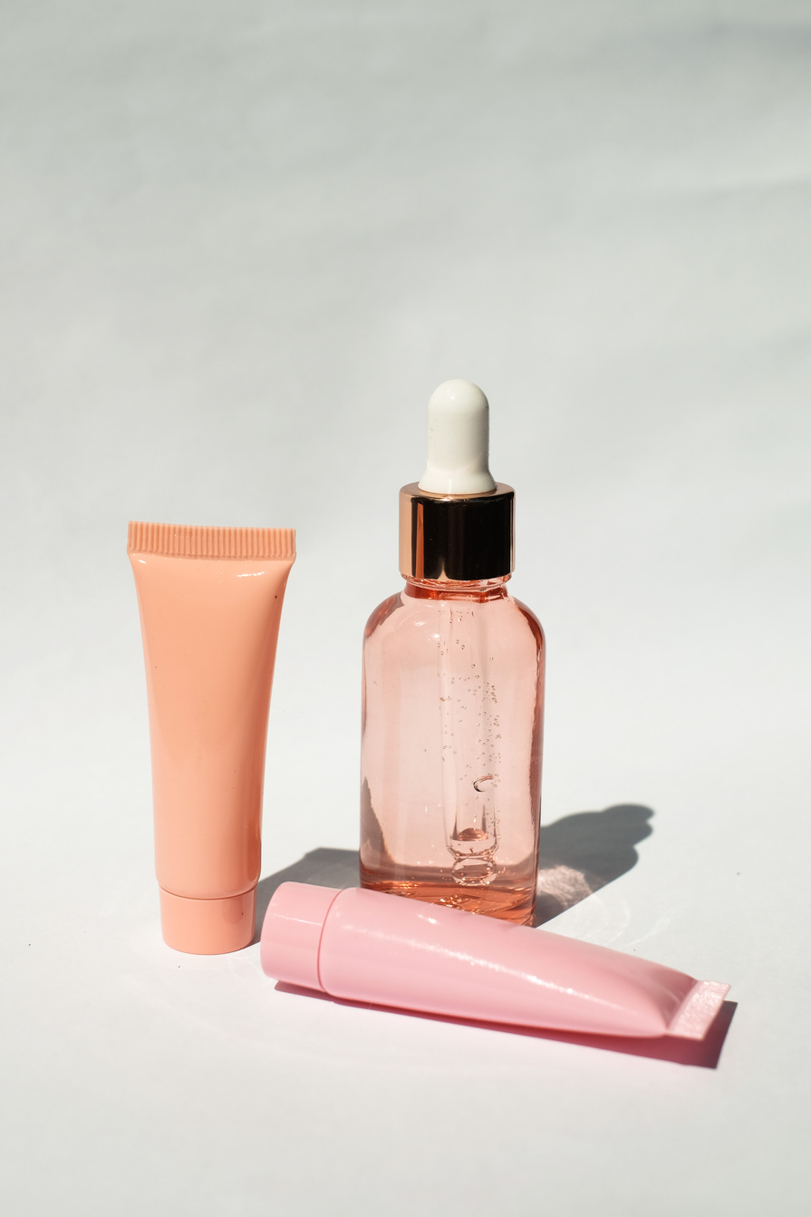
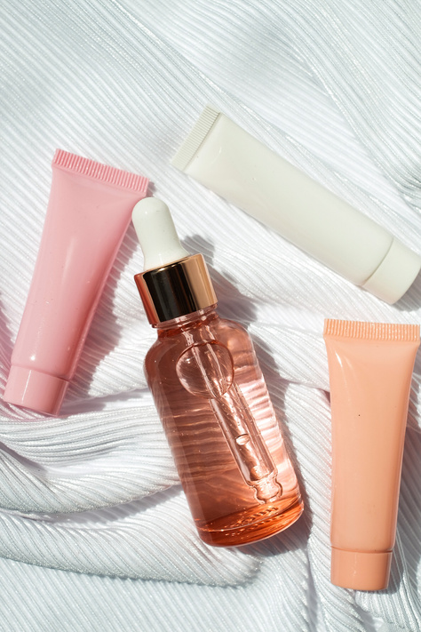
Existing System
Objective: The project uses AI and CNNs to analyze skin conditions and recommend suitable cosmetic products.
Skin Types: Classifies skin into Sensitive, Dry, Oily, and Combination, providing tailored product suggestions.
Data Handling: Uses preprocessed datasets (70% training, 15% validation, 15% testing) with methods like grayscale conversion and image resizing.
CNN Model: Employs deep learning layers for accurate skin analysis and product recommendations with over 85% accuracy.
Outcome: Enhances awareness of skin care and offers safe product suggestions, with potential future upgrades to advanced models.

Slide 5

Proposed System
A deep learning-based system using BERT (Bidirectional Encoder Representations from Transformers).
Enhanced understanding of textual data for skincare product reviews.
Variables'
Skin Type
Product
Brand
Ingredients
Cleaned Review
Category (Target).

Slide 6
Data Preprocessing
Label Encoding: Converts categories to numeric labels.
Input Text:
Combined fields like Skin Type, Product, Brand, Ingredients, and Review.
Data Splitting and Loading
Split: Train (80%) / Validation (20%).
PyTorch Datasets:
Train and Validation Data Loaders.
Batch Processing with shuffling.
Evaluation
Metrics: Precision, Recall, F1-Score (sklearn)

Slide 7
Flask Web Application
Features:
Homepage:
User-friendly input form.
Displays available categories.
Prediction Endpoint:
Processes input.
Returns category prediction.
Error Handling: Handles processing failures gracefully.
User Interaction Workflow
Inputs:
Skin Type, Product, Brand, Ingredients, Review.
Processing:
Text combined, tokenized, and fed to the model.
Outputs:
Predicted category displayed in real-time.

Slide 8
Results
Achieved an impressive 99% accuracy on the validation dataset, ensuring reliable skincare product classification.
Combined key textual features like Skin Type, Product, Brand, Ingredients, and Reviews to improve model performance.
Successfully deployed a Flask-based web application for real-time, accurate cosmetic category predictions.
Delivered high precision, recall, and F1-scores across all skincare categories, ensuring robust predictions.
Accurately categorized user inputs, demonstrating the system’s potential for practical cosmetic recommendations.

Slide 9
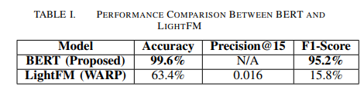
Analysis
Superior BERT Performance: The proposed BERT model achieves 99.6% accuracy and 95.2% F1-Score, far outperforming LightFM.
LightFM Weakness: LightFM (WARP) shows limited performance, with only 63.4% accuracy and a low 0.016 Precision@15.
Reliability of BERT: The BERT-based system ensures high accuracy and precision, making it ideal for personalized skincare recommendations

Slide 10
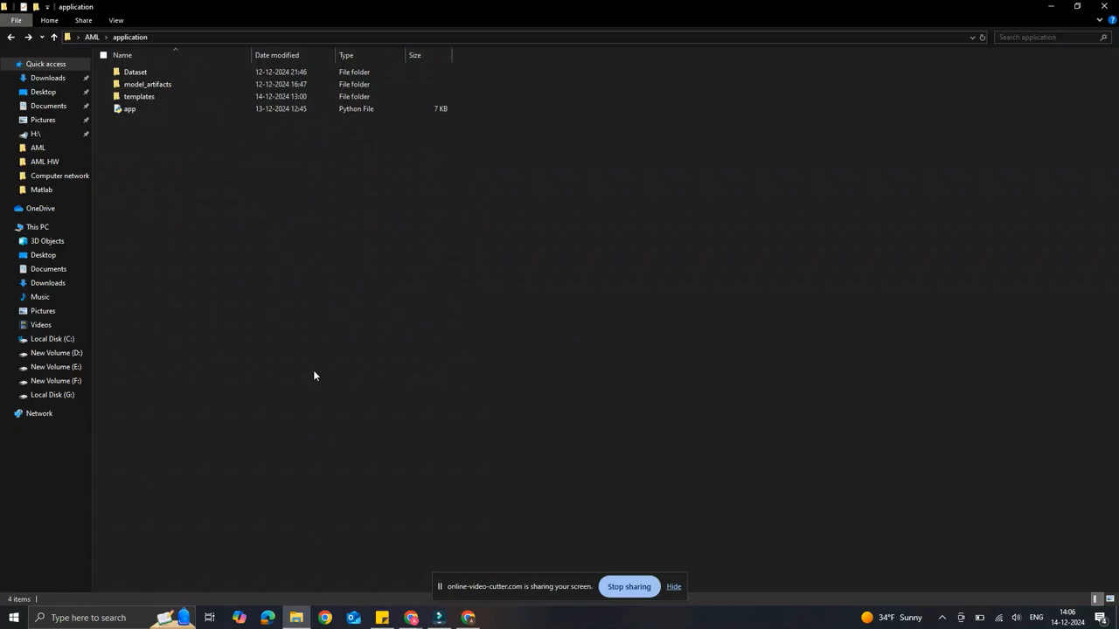
Demo

Slide 11
Conclusion
Achievements:
Successfully classified cosmetic suggestion using BERT.
Deployed a user-friendly web app for real-time predictions.
Future Work:
Improve model performance.
Add more product-specific features.
Explore real-world deployment at scale.

Slide 12
References
N. K. Ram and J. Kim, "Cosmetic Suggestion Based on Skin Condition Using Artificial Intelligence," Proceedings of the International Conference on Emerging Applications of Radiation in Society (ICEARS), 2023. DOI: 10.1109/ICEARS56392.2023.10085539.
Devlin, J., Chang, M. W., Lee, K., & Toutanova, K. (2019). BERT: Pre-training of Deep Bidirectional Transformers for Language Understanding. Proceedings of the 2019 Conference of the North American Chapter of the Association for Computational Linguistics: Human Language Technologies. https://arxiv.org/abs/1810.04805
Liu, Y., Ott, M., Goyal, N., Du, J., Joshi, M., Chen, D., Levy, O., Lewis, M., Zettlemoyer, L., & Stoyanov, V. (2019). RoBERTa: A Robustly Optimized BERT Pretraining Approach. https://arxiv.org/abs/1907.11692
Sebastiani, F. (2002). Machine Learning in Automated Text Categorization. ACM Computing Surveys, 34(1), 1-47. https://dl.acm.org/doi/10.1145/505282.505283

Slide 13
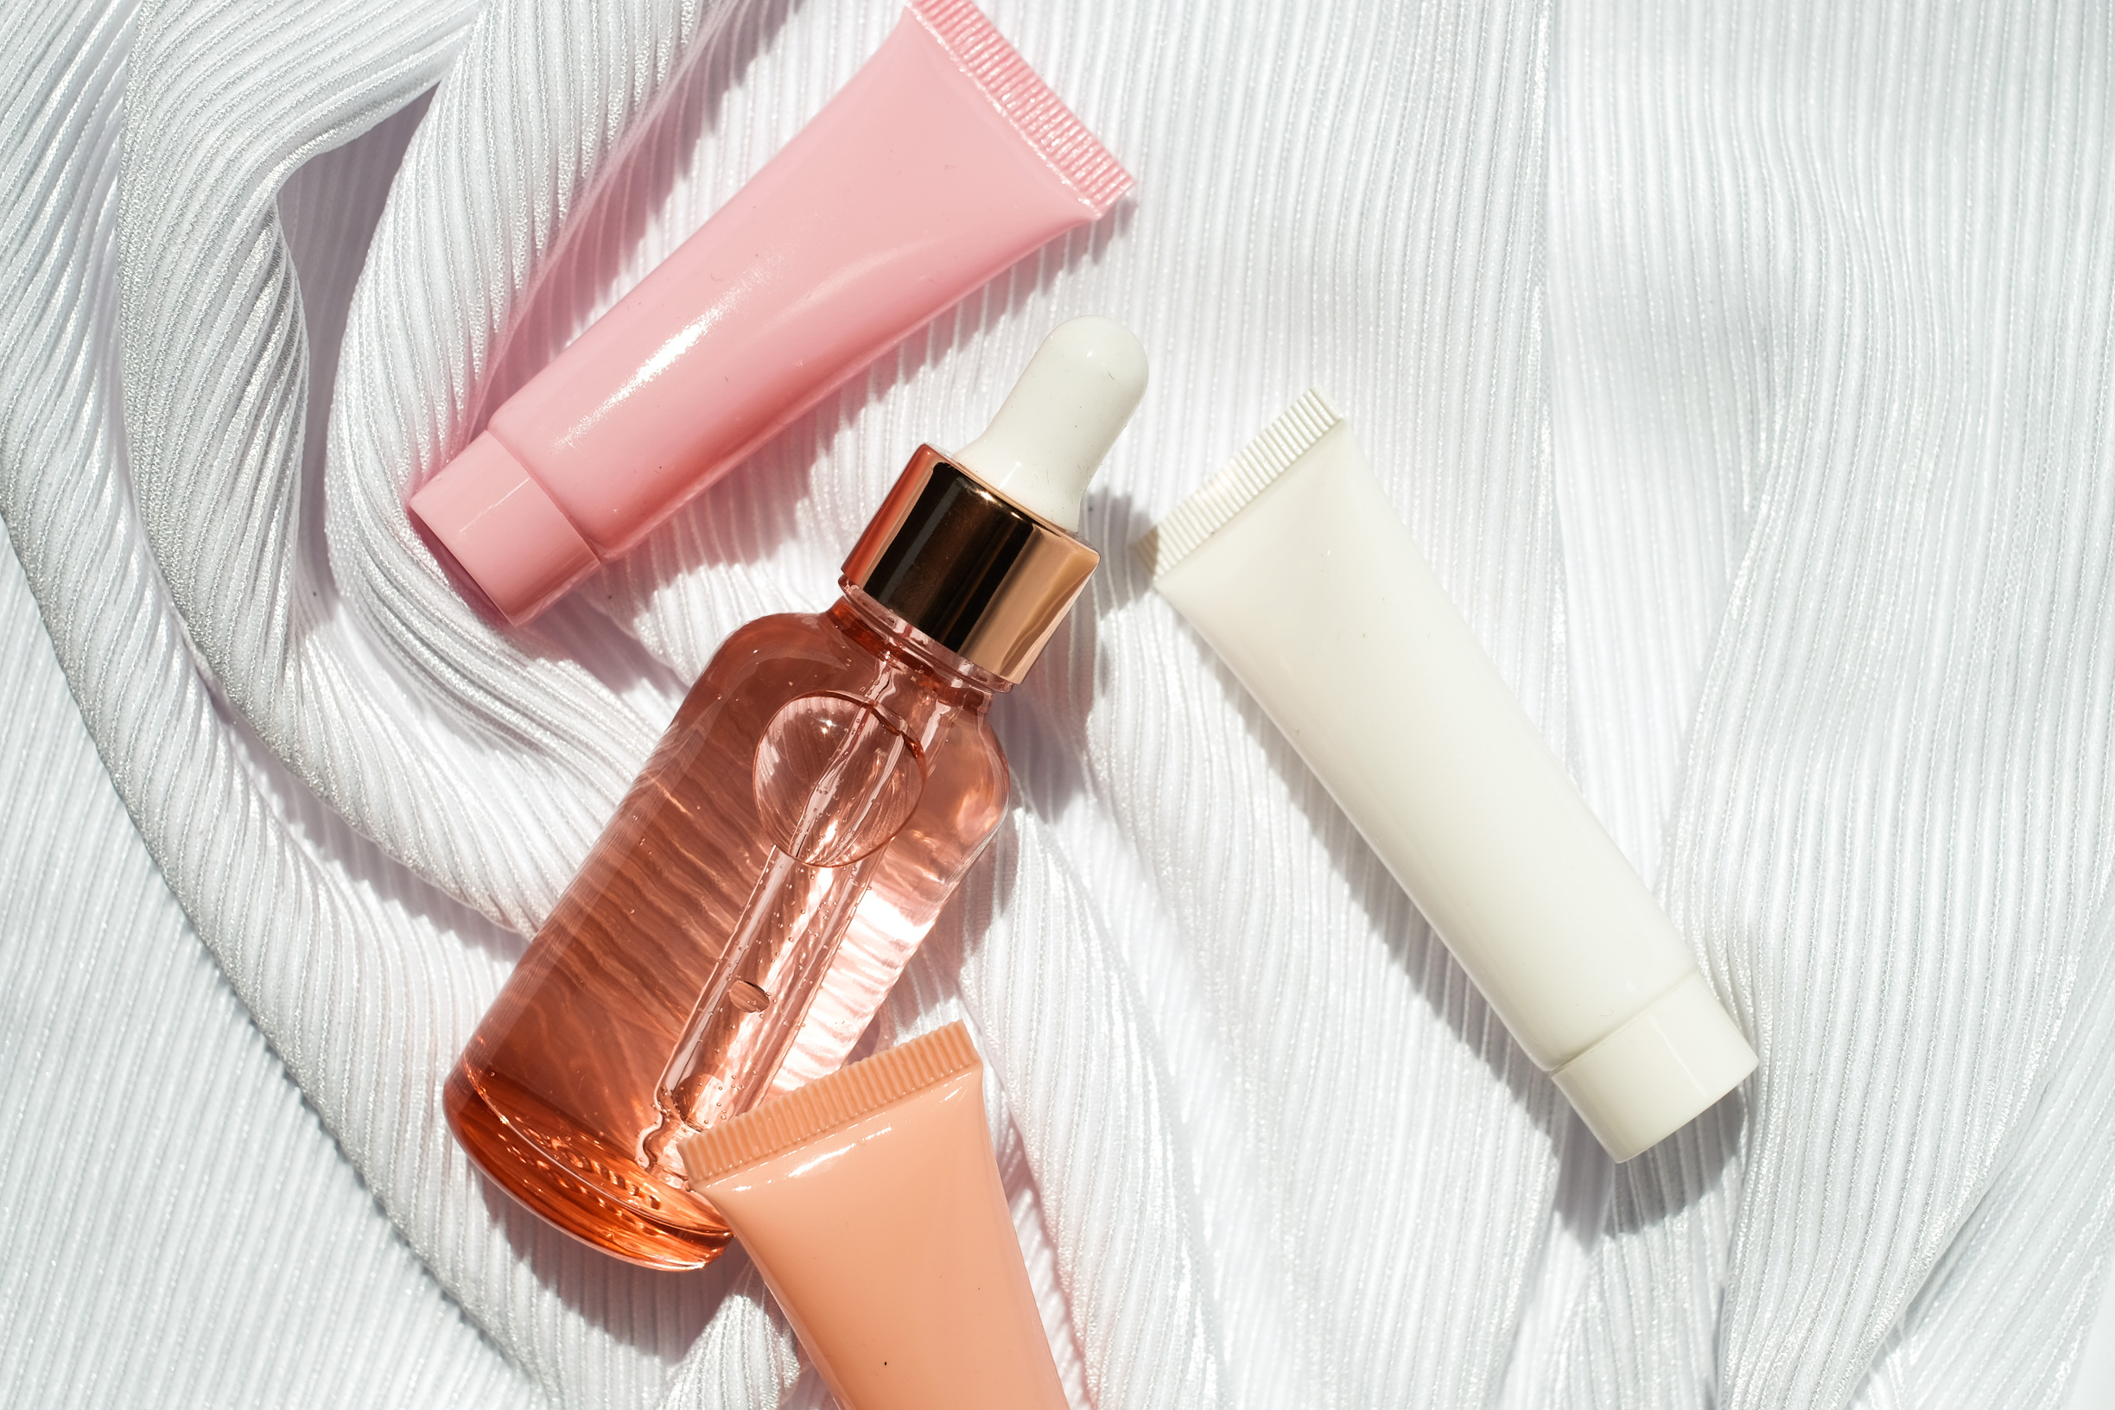
Thank You

